Slide 1
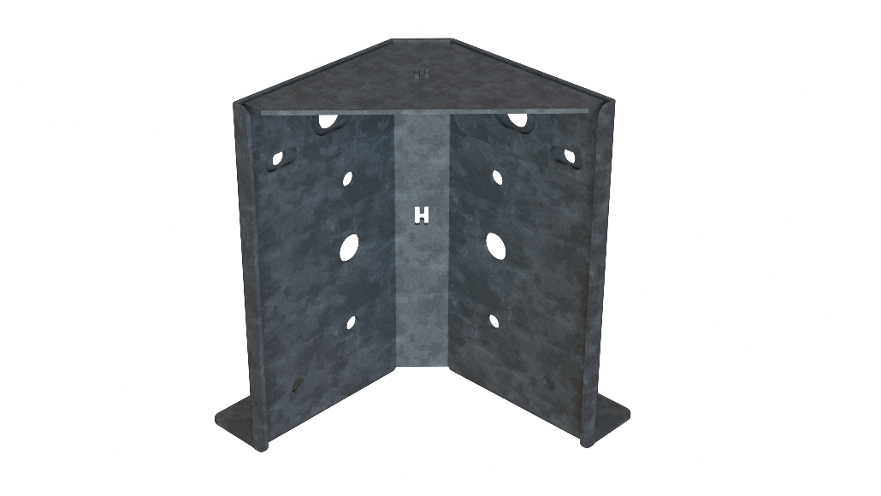
Corner Beam Bracket Assembly
Featuring:
The H2-GCB Bracket
209 Tidwell Drive Alpharetta, Georgia 30004 Office 770-777-7007 ~ ext. 234 E-mail: info@hdgep.com
USPTO No. 10,024,046: Bracket Bracing System - Copyright© 2018 HDG, Inc. All Rights Reserved - Terms of Use Listed @ www.hdgep.com

Slide 2
INSTALLATION GUIDE FOR SINGLE STORY BRACKETS
Read Guide Completely Before Installation
Check for Additional Requirements
Per Deck Design Professional AND local code authority
Water Intrusion
**INSTALLER IS RESPONSIBLE FOR PREVENTING WATER INTRUSION**
Verify all bolts and caulks are tightened
Fasteners:
Installed ONLY in provided and specified holes
Are to meet or exceed local code requirements.
Recommended: HDG ASTM 123 Hot Dipped Galvanized or Stainless Steel
Certifications:
HDG, Inc. Engineered Products: Subject to 1 Year Limited Warranty
USPTO: No. 10,024,046: Bracket Bracing System
Copyright © 2018 HDG, Inc. ~ All Rights Reserved
Terms of Use: Listed @ www.hdgep.com
Instructions are not intended to replace deck construction plans.
Shown for product illustration purposes only.
Contact: info@hdgep.com or 770) 777-7007 Ext 234 for Additional Information
See www.hdgep.com for Instructional Video and Individual Product Specifications

Slide 3
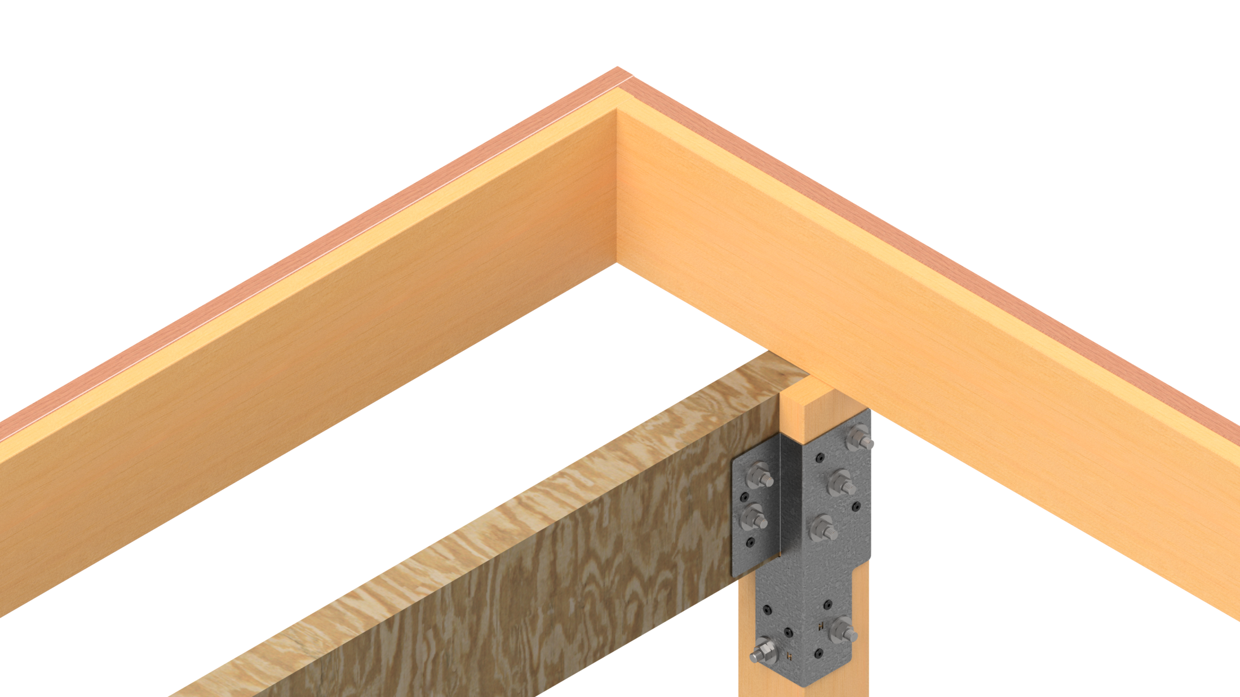
Lay framing upon constructed beam and ledger. A cantilevered deck is used to display the function of this bracket. It can be used for similar purposes.
Double Rim Joist
Beam
(Side of Deck)
(Front of Deck)
In this case, we are using (2) 2x12’s for beam and rim joist.
Nail overlapped boards typically to hold them in place.

Slide 4
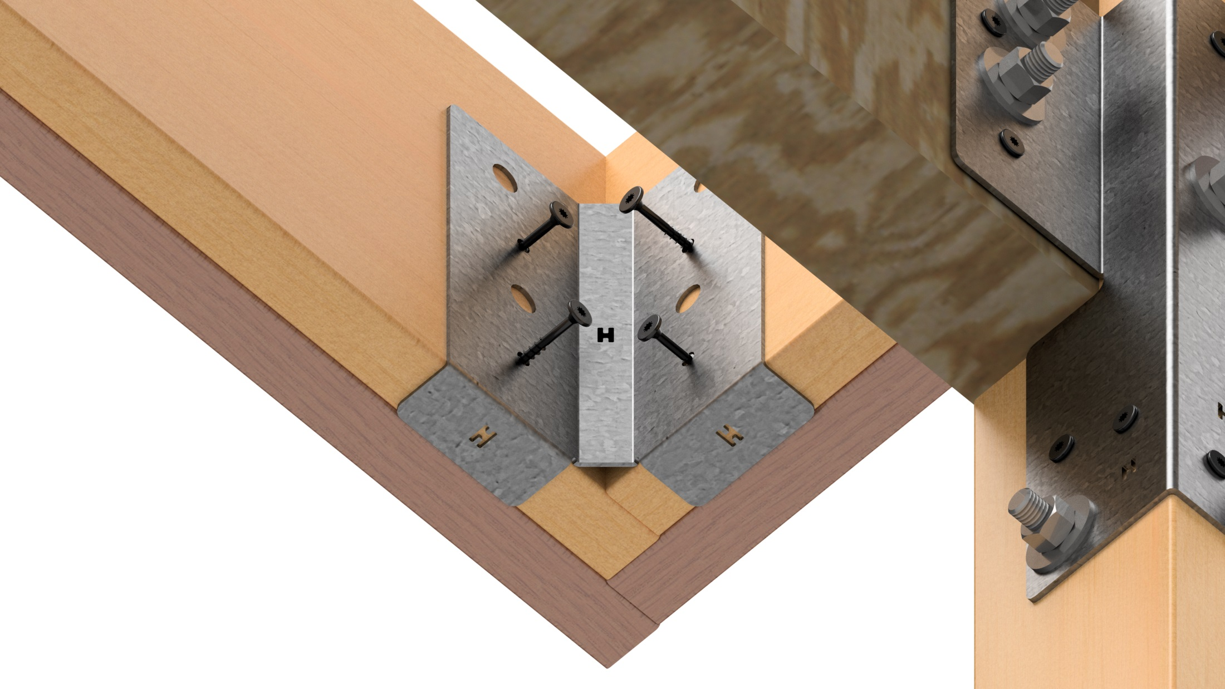
Place the H2-GCB bracket flush against corner, ensuring the bracket
is flush along the bottom of the rim joist and beam.
Beam
(Front of Deck)
Double Rim Joist
(Side of Deck)
For Single Rim Joist use a 12” long block to permit proper frame spacing.
(Optional: can use screws or nails to temporarily hold in place.)

Slide 5
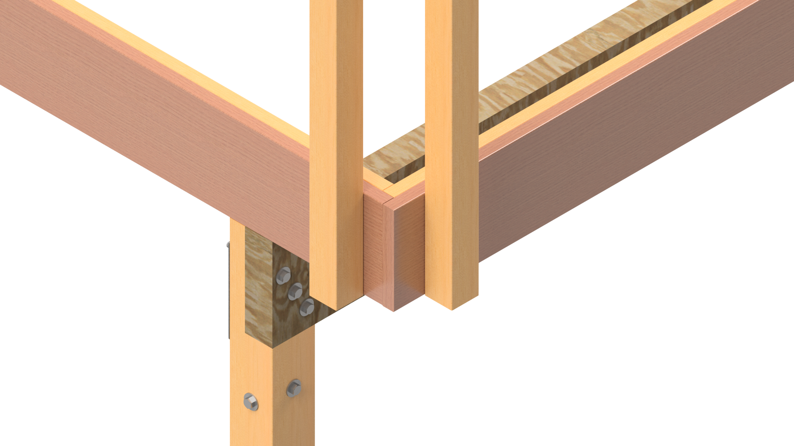
Cut 4x4 handrail posts and toenail or clamp them so that they align with the bolt holes on the bracket side flanges.
Double Rim Joist
Beam
(Side of Deck)
(Front of Deck)
~3”
~

Slide 6
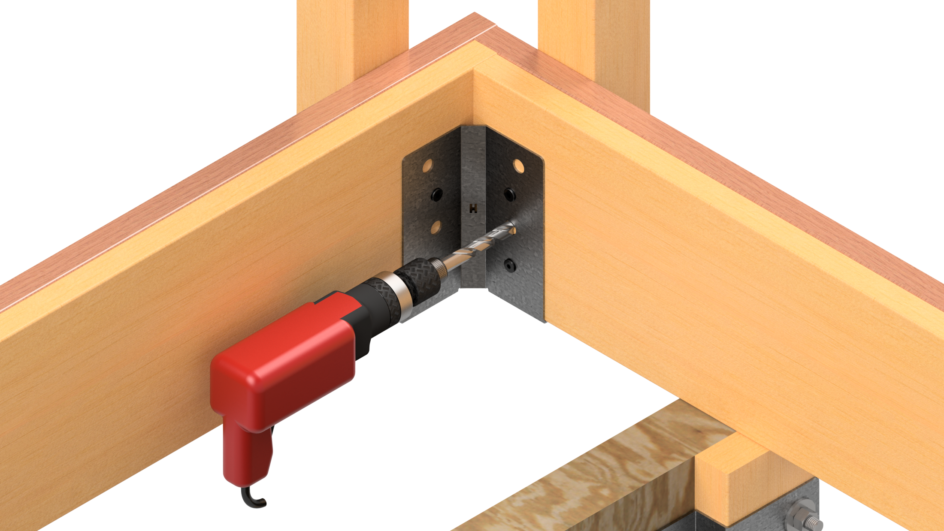
Drill, using each bolt hole in bracket as guides, through all lumber with a minimum ½” hole for ½” bolts or 5/8” hole for 5/8” bolts.

Slide 7
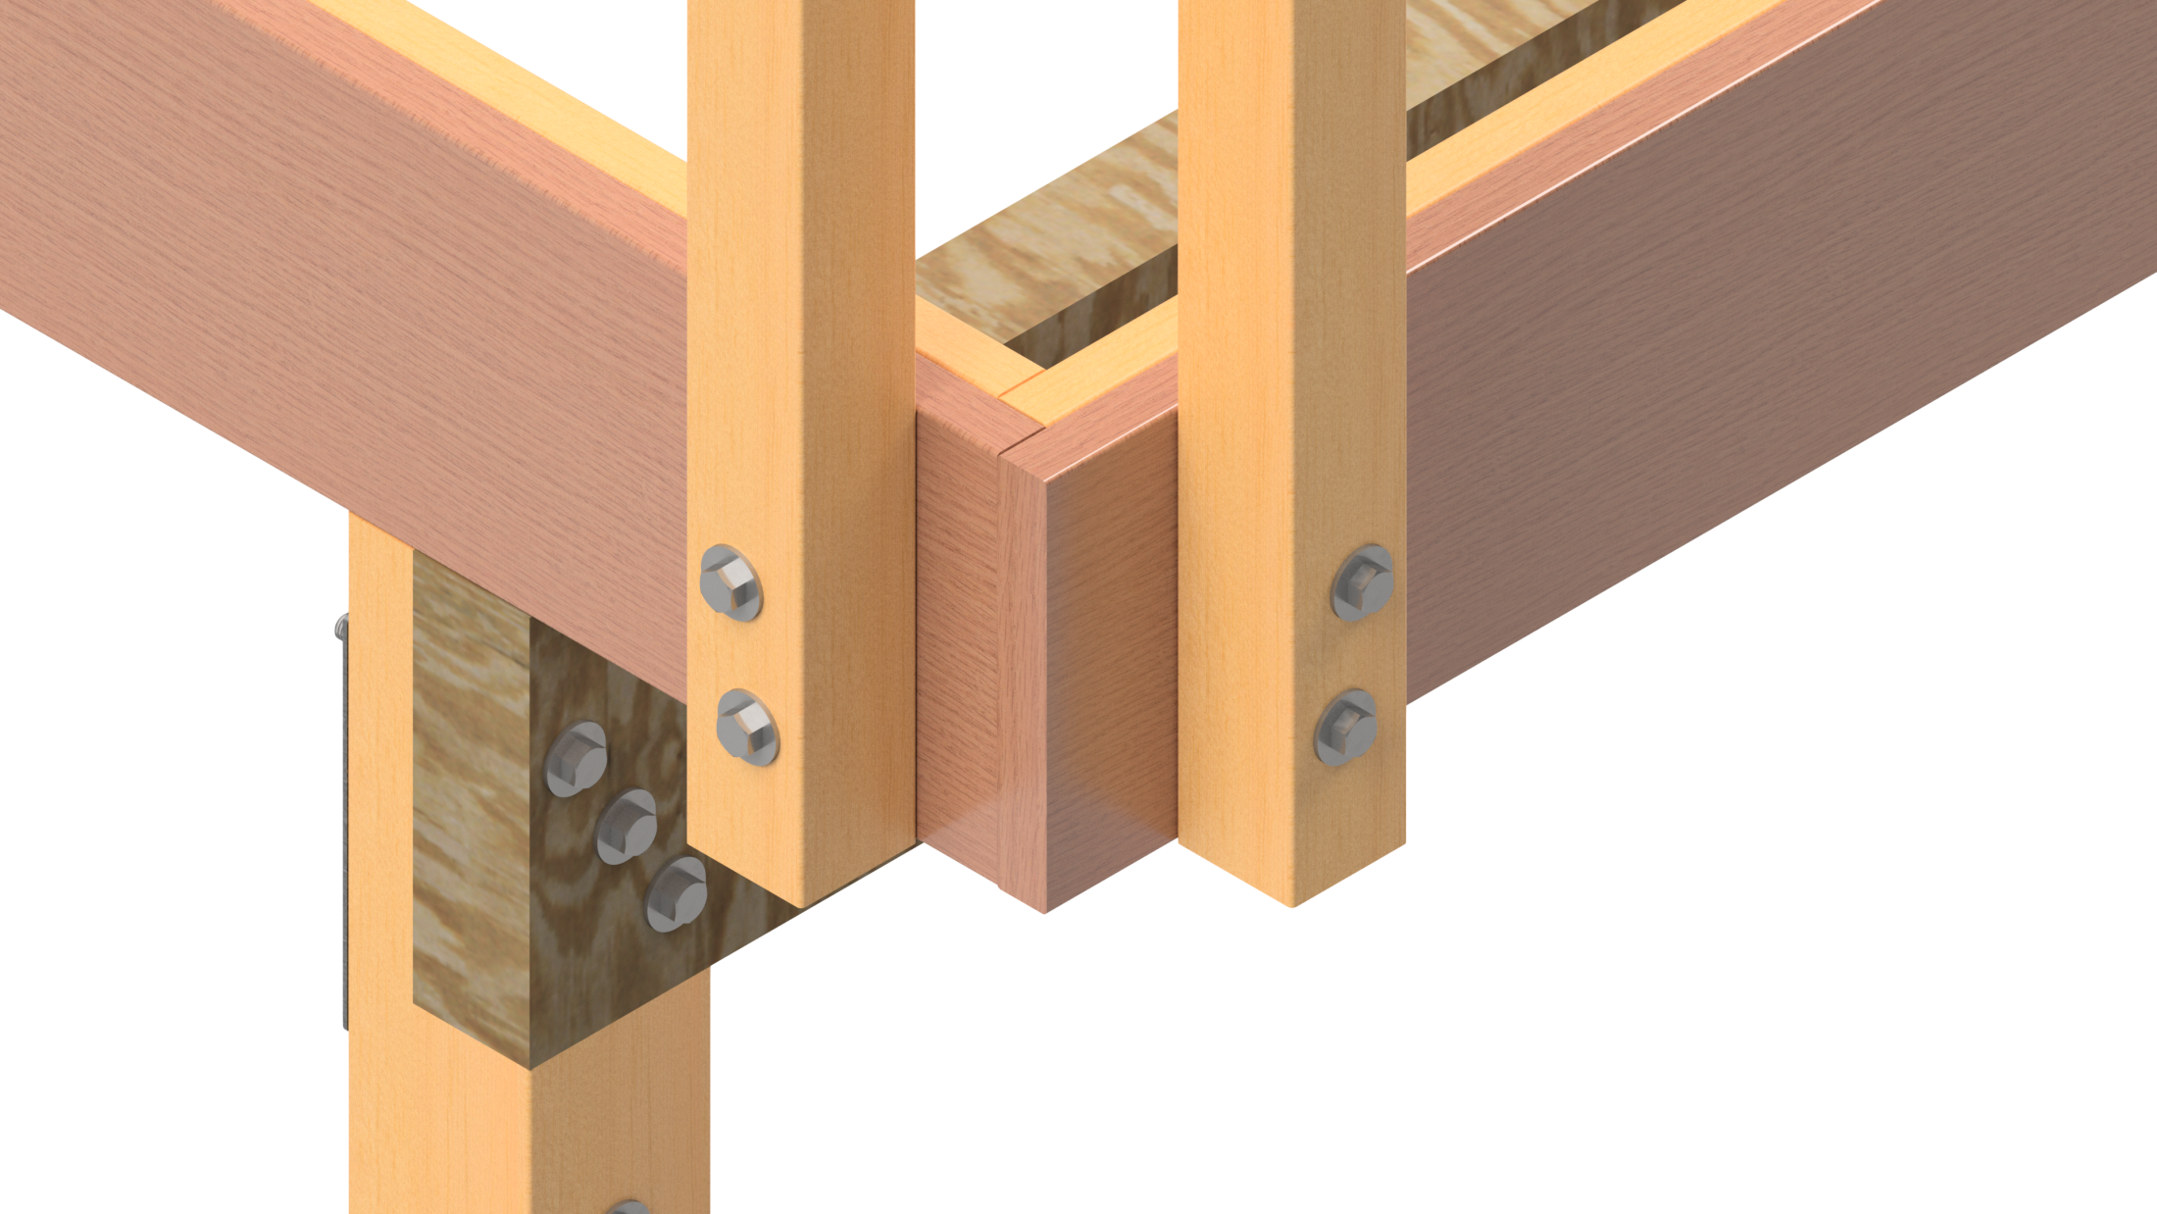
Installing bolts through the outside, fasten them inside the deck with code approved fasteners.

Slide 8
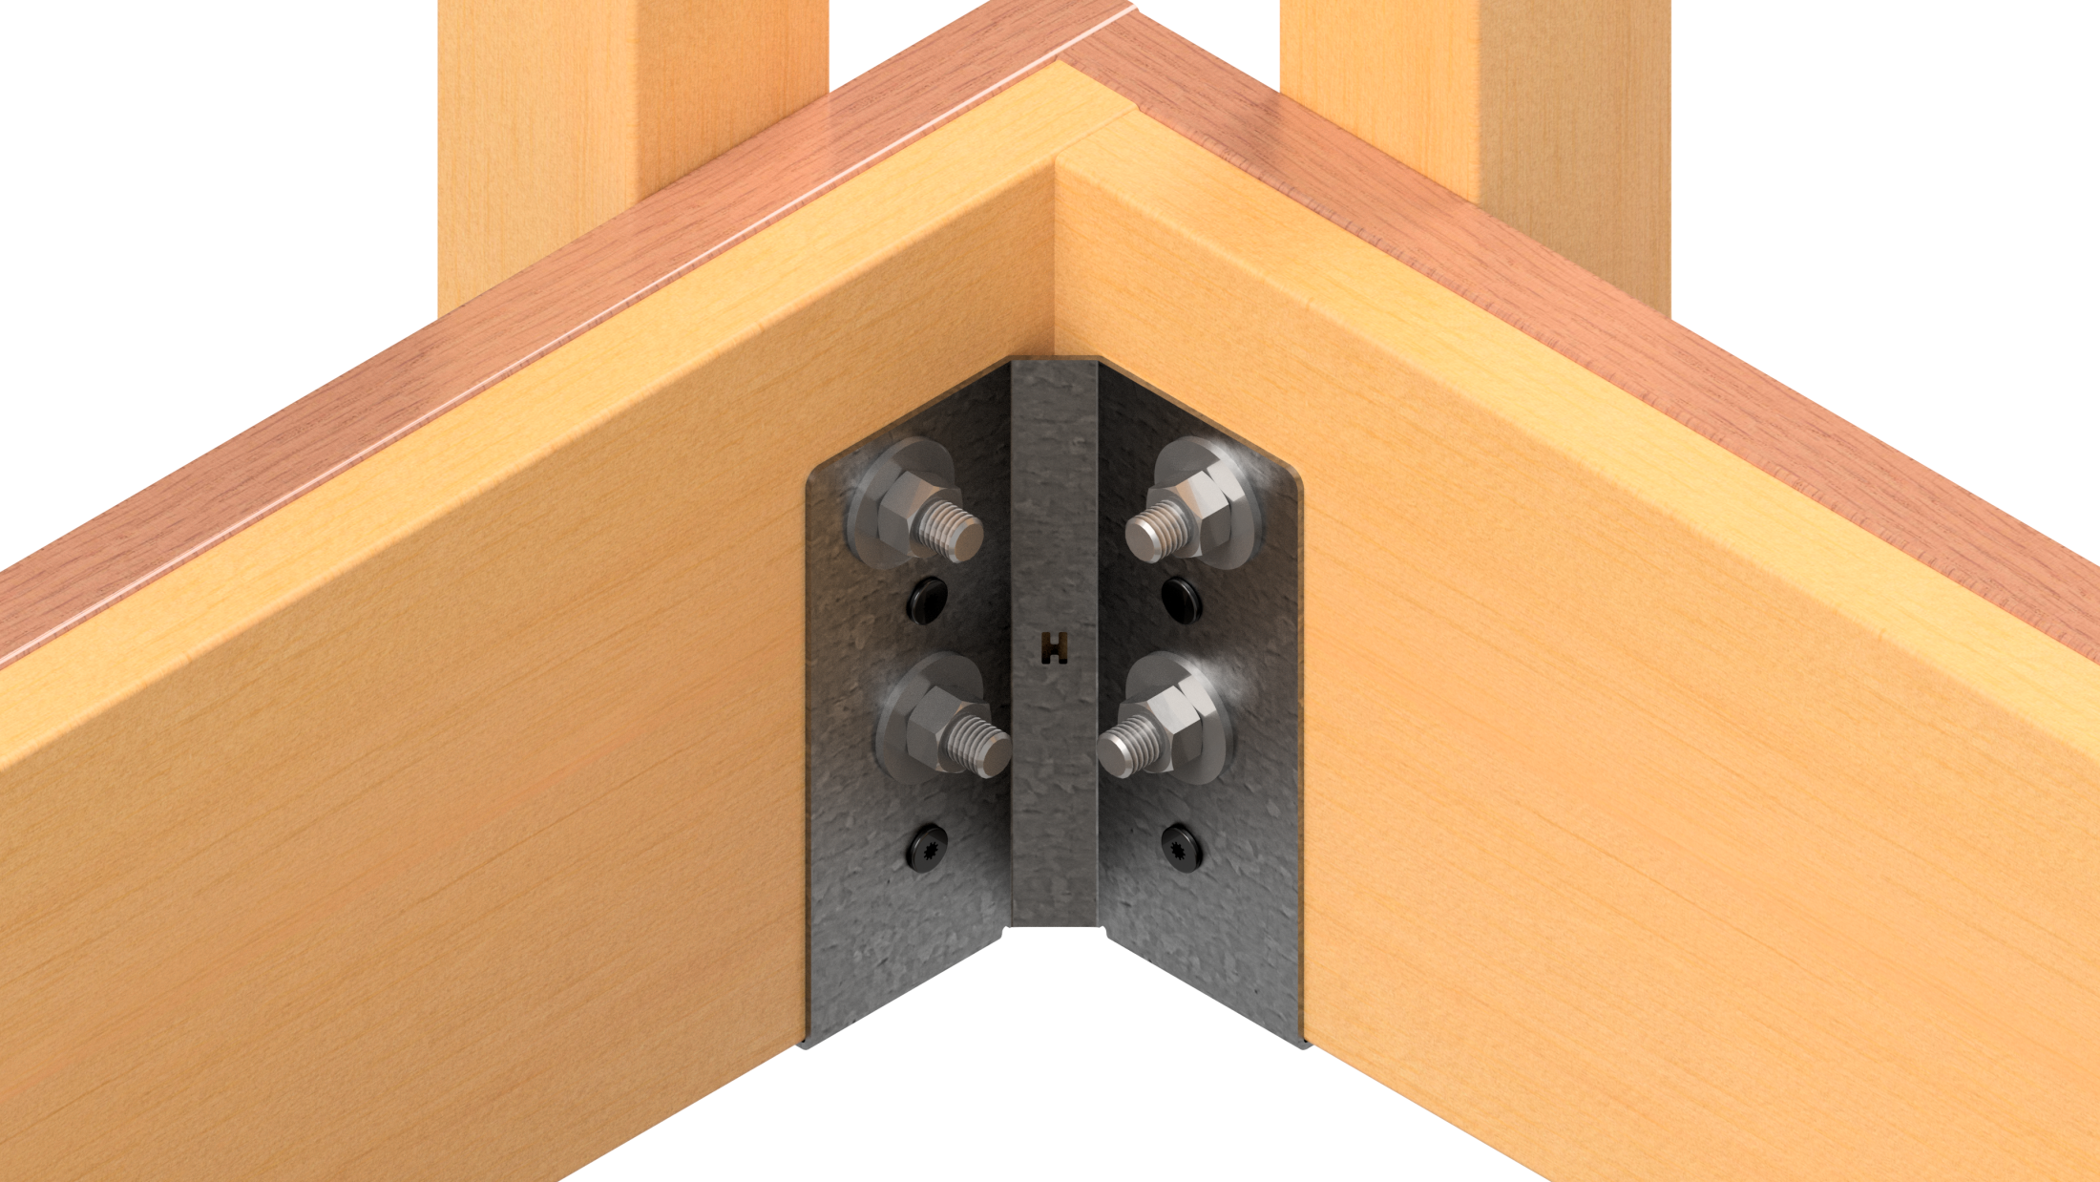
Torque per recommended wood council specs. Bolts are ½” diameter minimum.
(4) 7.5” HDG Bolts
A307 bolts 5/8” thick should be torqued to 73 ft/lbs. A307 bolts ½” thick should be torqued to 37 ft/lbs.

Slide 9
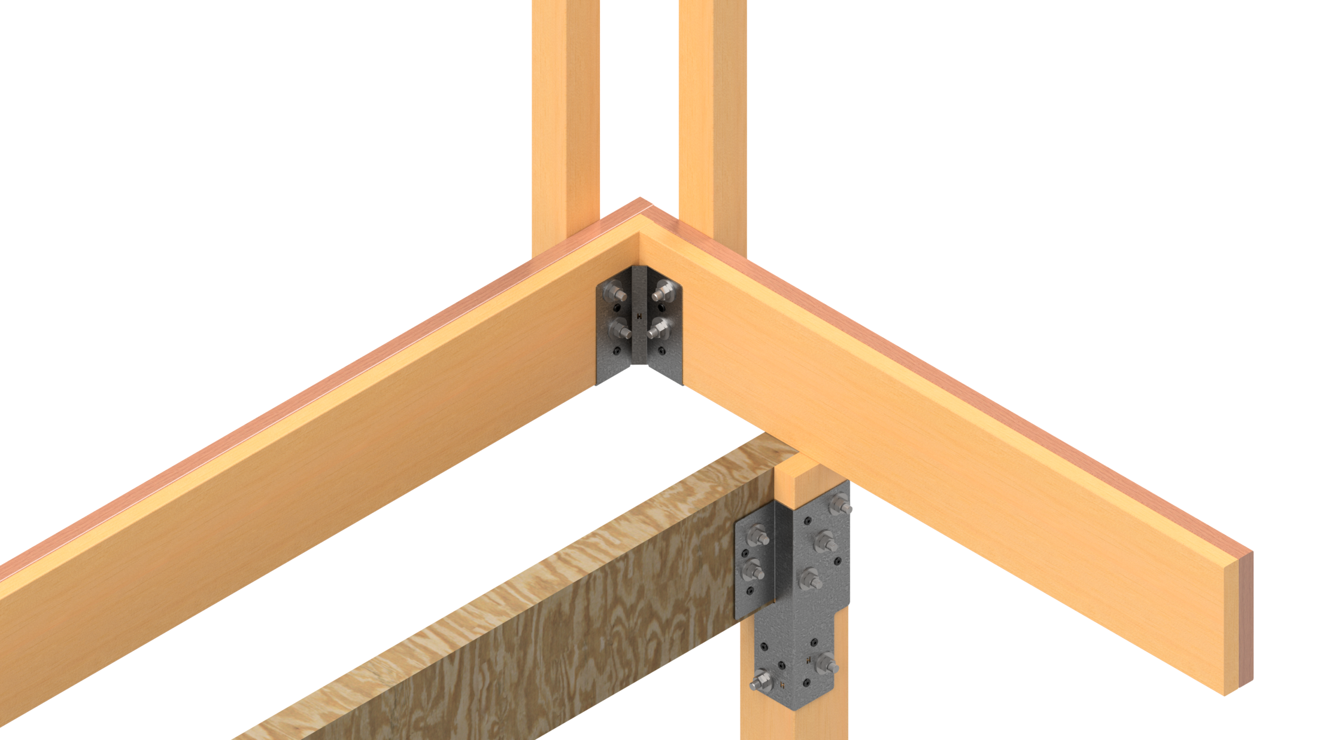
Installation Complete!

Slide 10
Corner Beam Bracket Assembly Guide
* Read Guide Completely Before Installation *
Certifications
HDG, Inc. Engineered Products: Subject to 1 Year Limited Warranty
USPTO: No. 10,024,046: Bracket Bracing System
Copyright © 2018 HDG, Inc. ~ All Rights Reserved
Terms of Use: Listed @ www.hdgep.com
Instructions are not intended to replace deck construction plans.
Shown for product illustration purposes only.
Contact: info@hdgep.com or 770) 777-7007 Ext 234 for Additional Information
See www.hdgep.com for Instructional Video and Individual Product Specifications

