Slide 1
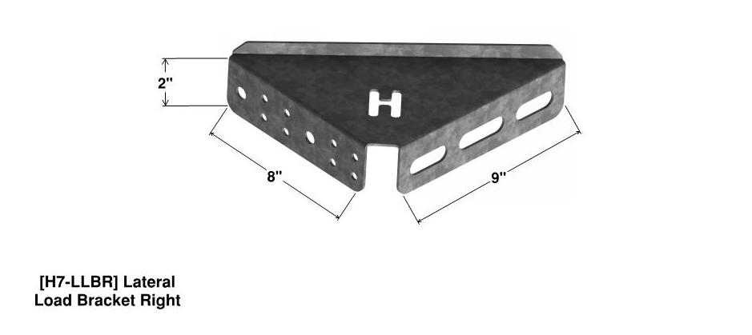
Deck Lateral Load Bracket Assembly
Featuring:
The H7-LLB Bracket
209 Tidwell Drive Alpharetta, Georgia 30004 Office 770-777-7007 ~ ext. 234 E-mail: info@hdgep.com
USPTO No. 10,024,046: Bracket Bracing System - Copyright© 2018 HDG, Inc. All Rights Reserved - Terms of Use Listed @ www.hdgep.com -

Slide 2
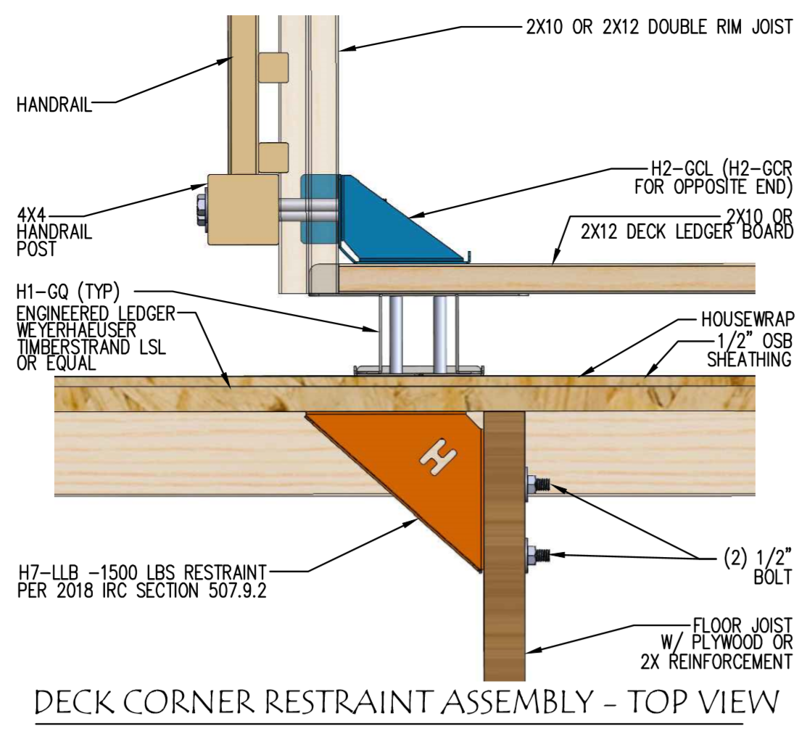
Located within 2’ of end of deck

Slide 3
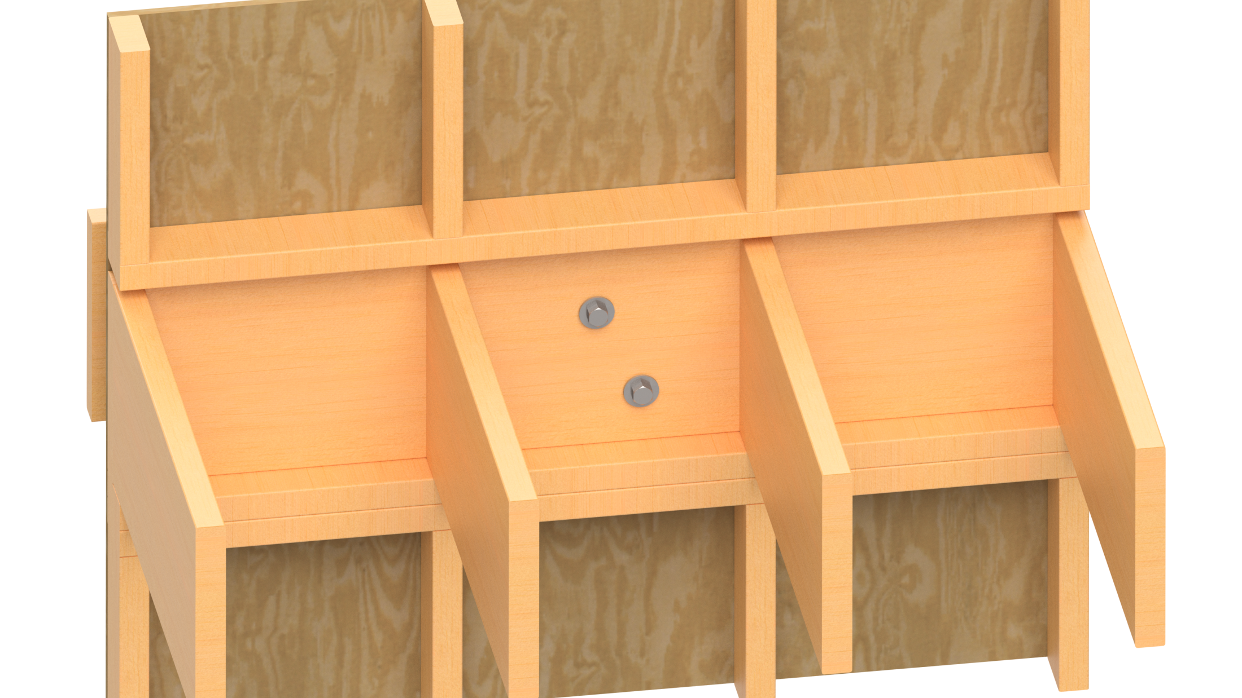
Identify the H2 series bracket or ledger bolt closest to the floor joist you want to attach to.

Slide 4
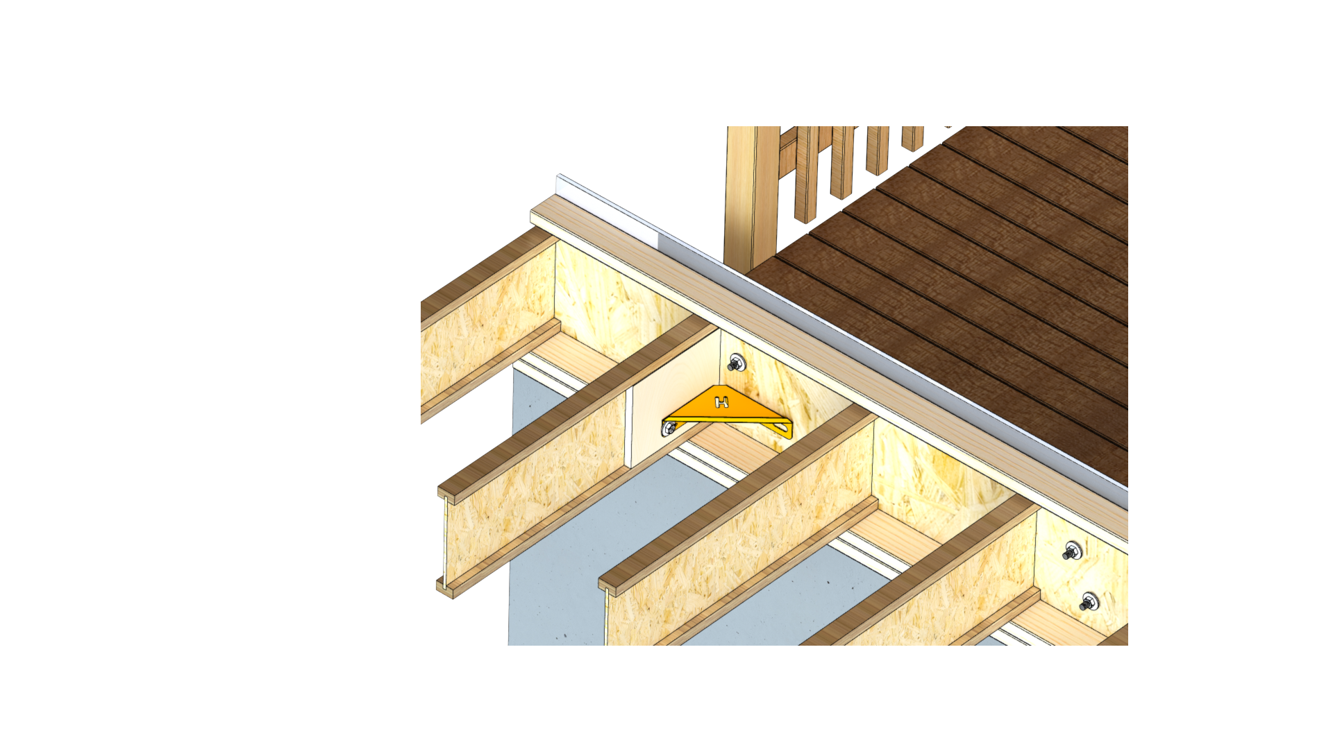
Position the lateral load bracket utilizing the available space within 2’ of the end of the deck per 2018 IRC.
Example of a Deck Lateral Load Bracket
H7-LLB Installed Facing Down
Use the ledger bolt to fasten to the inside of the rim joist.

Slide 5
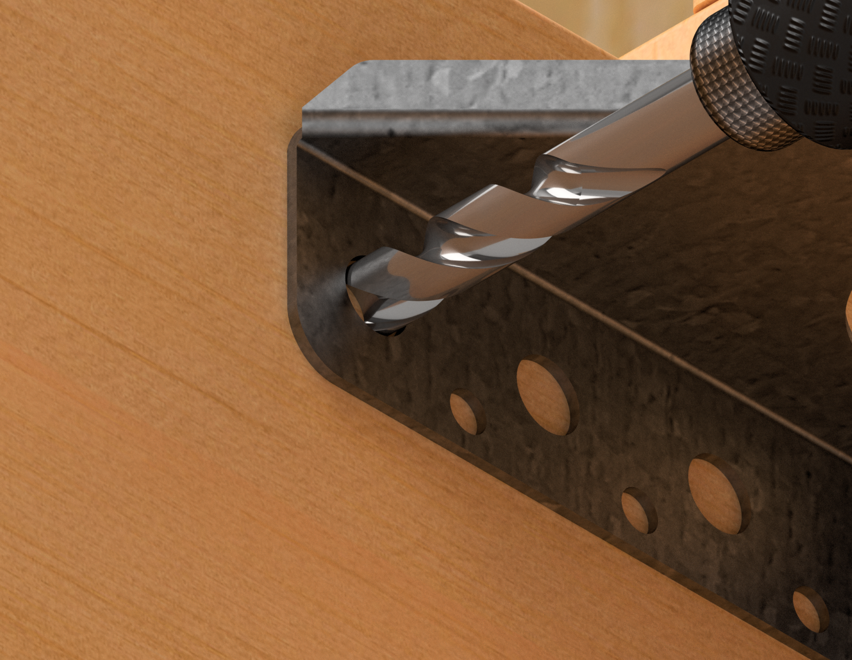
Drill 2 additional holes for bolts in floor joist after reinforcing with ½” (min) plywood on each side or use 8 structural screws each.

Slide 6
Fasten 2 bolts per bracket minimum. Use ½” thread HDG steel bolts or use 8 structural screws each.

Slide 7
Bottom view illustration.
H7-LLB Lateral Load Bracket
Floor Joist
First Floor Wall Stud
Top Bolt
Ledger
Rim Joist
Top plate

Slide 8
Top view with plywood subfloor removed to illustrate side bolts.
Zoom View

Slide 9
Top view to illustrate use with other post brackets.
(H2-GCR)
Corner Bracket
With Gusset Plate
Ledger
(H1-GQ)
4” Space For Brick
Queen Bracket
Wall Studs
1/2” HDG Steel Bolts or 8 Structure Screws each
(H7-LLB)
Lateral Load Bracket
Floor Joists

Slide 10
With 4” Space Filled in Top View
(H2-GCR)
Corner Bracket
With Gusset Plate
Ledger
(H1-GQ)
4” Space For Brick
Queen Bracket
Wall Studs
1/2” HDG Steel Bolts or 8 Structural Screws each
(H7-LLB)
Lateral Load Bracket
Floor Joists

Slide 11
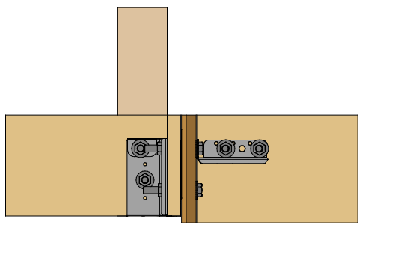
Deck Corner Restraint Assembly – Front Side View
As applied to Siding
4x4
Handrail Post
H2-GCL
Corner Bracket
With Gusset Plate
1/2” HDG Steel Bolts
H7-LLB
Lateral Load Bracket
Floor Joists
Ledger
Rim Joist
Siding (Non-brick house)
Rim Board

Slide 12
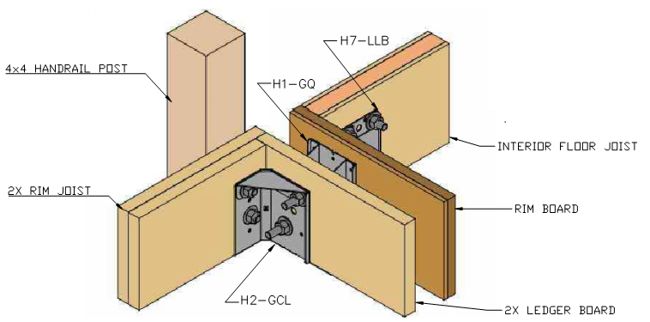
Deck Corner Restraint Assembly – Side View
As applied to Brick (With Queen Bracket)

Slide 13
Deck Corner Restraint Assembly – Top View
As applied to Brick (With Queen Bracket)

Slide 14
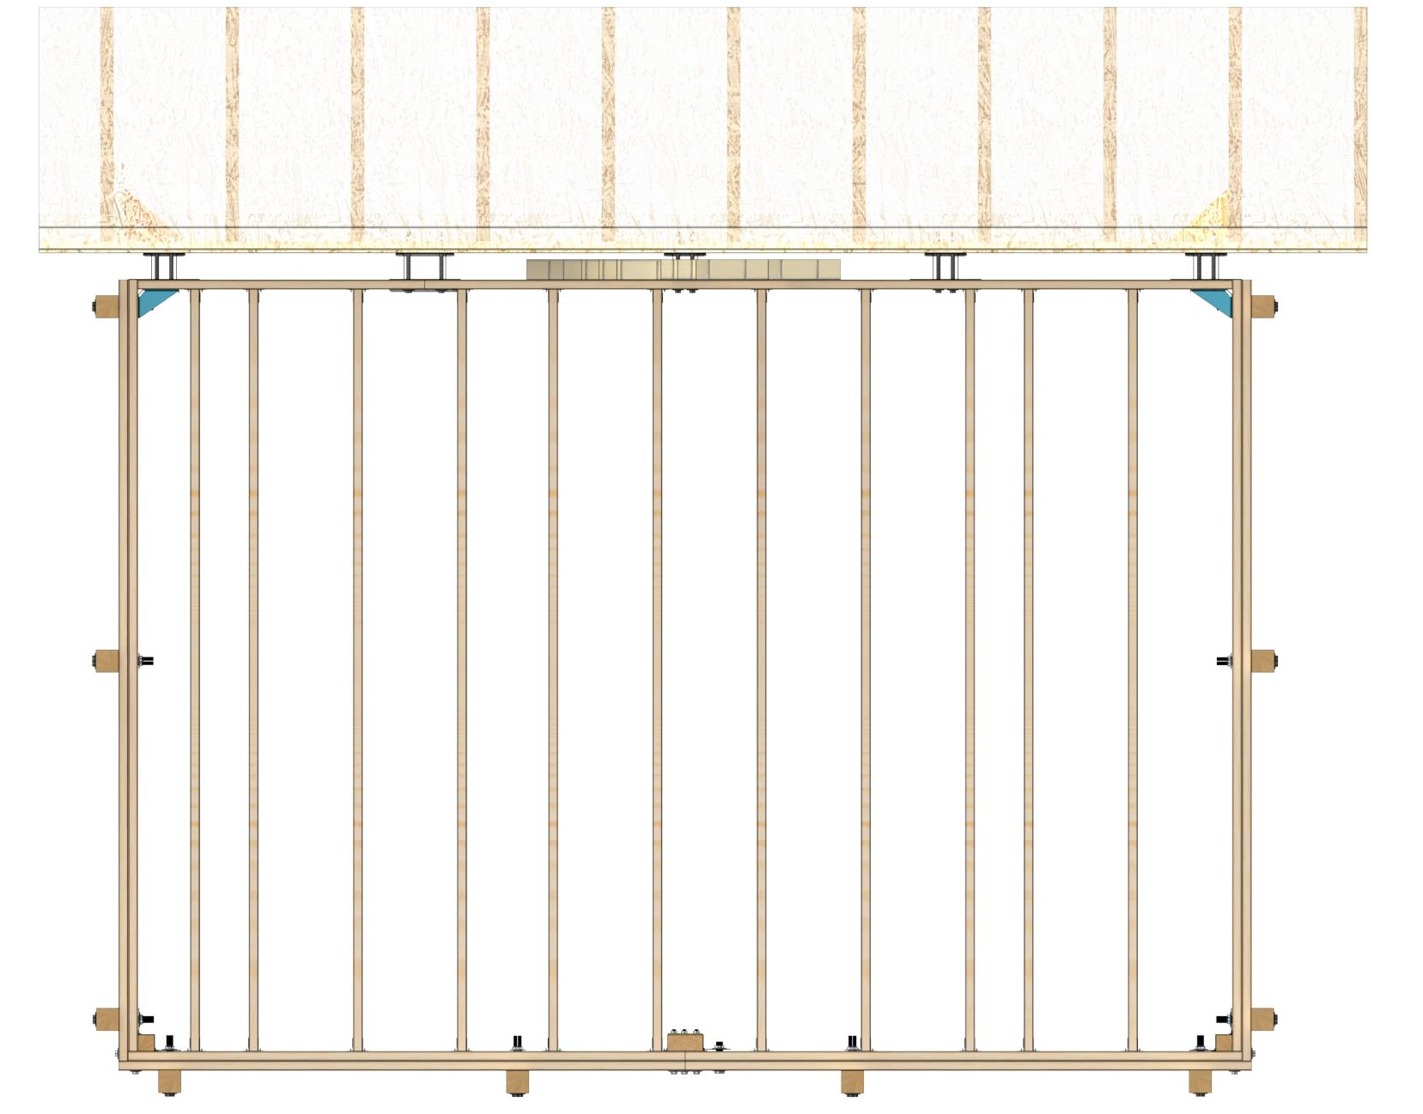
Deck Corner Restraint Assembly – Full Deck Top View
As applied to Brick (With Queen Bracket)

Slide 15
INSTALLATION GUIDE FOR DECK LATERAL LOAD BRACKETS
Read Guide Completely Before Installation
Check for Additional Requirements
Per Deck Design Professional AND local code authority
Fasteners:
Installed ONLY in provided and specified holes
Are to meet or exceed local code requirements.
Recommended: Fasten Master Headlock 2-7/8” Structural Wood Screws
Certifications:
HDG, Inc. Engineered Products: Subject to 1 Year Limited Warranty
USPTO: No. 10,024,046: Bracket Bracing System
Copyright © 2018 HDG, Inc. ~ All Rights Reserved
Terms of Use: Listed @ www.hdgep.com
Instructions are not intended to replace deck construction plans.
Shown for product illustration purposes only.
Contact: info@hdgep.com or 770) 777-7007 Ext 234 for Additional Information
See www.hdgep.com for Instructional Video and Individual Product Specifications

Slide 16
Lateral Load Bracket Assembly Guide
* Read Guide Completely Before Installation *
Certifications
HDG, Inc. Engineered Products: Subject to 1 Year Limited Warranty
USPTO: No. 10,024,046: Bracket Bracing System
Copyright © 2018 HDG, Inc. ~ All Rights Reserved
Terms of Use: Listed @ www.hdgep.com
Instructions are not intended to replace deck construction plans.
Shown for product illustration purposes only.
Contact: info@hdgep.com or 770) 777-7007 Ext 234 for Additional Information
See www.hdgep.com for Instructional Video and Individual Product Specifications

